Slide 1
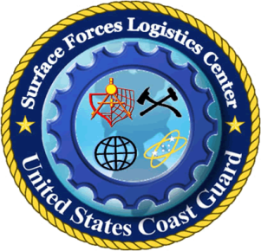
Surface Forces
Logistics Center
US Coast Guard
Update on Contract Opportunities
National Security Cutter Program (WMSL 750-758)
Mr. James Landreth, P.E.
WMSL Propulsion System, Lead Engineer
SFLC exists to Support the Fleet

Slide 2
Mission Focused
DHS Mission:
With honor and integrity, we will safeguard the American people, our homeland, and our values.
USCG Mission:
Protect the public, the environment, and US economic interests…in any maritime region as required to support national security.

Slide 3
Mission Sets
Defense Readiness
Drug Interdiction
Migrant Interdiction
Law Enforcement
Ice Operations
Marine Environmental Protection
Search & Rescue
Marine Safety
Port & Waterway Security
Aids to Navigation
Living Marine Resources

Slide 4
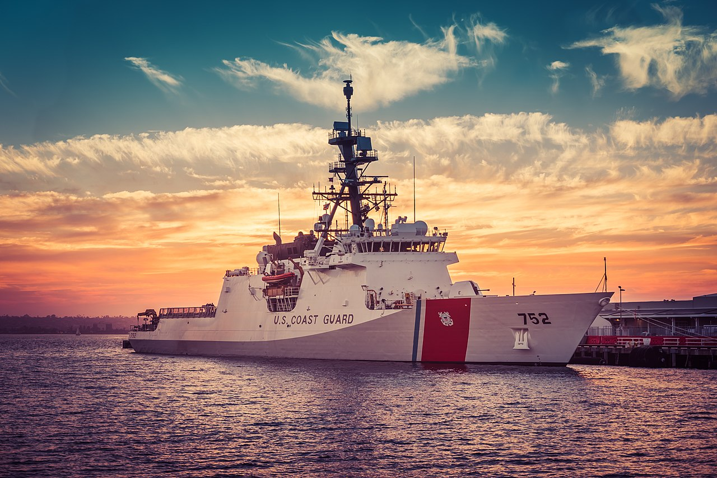
National Security Cutter
Notes:
Length 418 feet
Beam 54 feet
Draft 22 feet 6 inches (projection draft)
Displacement 4,500 long tons
Max Speed 28+ Knots
Range 12,000 NM (economical speed)
Endurance 60 to 90 days
Complement 127 (17 Officers)
Flight Deck Deploy with and USCG MH-65 and capability for Navy-60R/S
Small Boats 2 OTH MKIV & 1 LRI-II

Slide 5
Defense Readiness

Slide 6
Rim of the Pacific Exercise (RIMPAC)

Slide 7
MQ-8B Fire Scout

Slide 8
Scan Eagle Recovery

Slide 9
Drug Interdiction

Slide 10
Drug Interdiction

Slide 11
Drug Interdiction

Slide 12
Migrant Interdiction/Law Enforcement

Slide 13
Ice Operations

Slide 14
Ship Repair Opportunities
WMSLs are “optimally manned”
Ship repair opportunities include:
Hull
Mechanical
Electrical
Navigation/Electronics
Damage Control and Lifesaving Equipment

Slide 15
Ship Repair Opportunities
Hull
General Welding
Specialized Welding
Diving Operations
Hull Cleaning
Painting/Coating
Mechanical
Deck Equipment
Crane Hydraulics
High P Air Systems
Diesel Engines
Shafting/Propellers

Slide 16
Ship Repair Opportunities
Electrical
Switchboard testing
Load bank operations
Wiring Upgrades
Generator overhaul
EMI Testing
Navigation/Electronics
Installation
Grooms
Upgrades
Prototype Evaluations
Various classification levels

Slide 17
Ship Repair Opportunities
Damage Control and Lifesaving Equipment
AFFF
Fire Suppression (FM200/R102)
CO2
Water Mist
Quick Acting WTD

Slide 18
North Charleston, SC

Slide 19
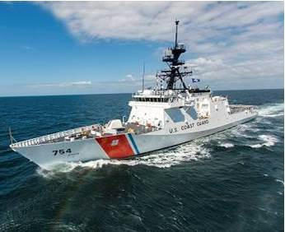
Home Ported in Charleston
CGC HAMILTON (WMSL 753)
CGC JAMES (WMSL 754)
CGC STONE (WMSL 758) (FY21)*

Slide 20
Charleston Contract Opportunities
CGC HAMILTON | Notional Dates | Length
Dockside FY18 FQ2 | 2/28/18 – 5/22/18 | 83 days, 12 weeks
Dockside FY18 FQ4 | 8/5/18 – 9/29/18 | 55 days, 8 weeks
Dockside FY19 FQ2 | 1/2/19 – 3/26/19 | 83 days, 12 weeks
Dockside FY19 FQ3 | 7/7/19 – 8/31/19 | 55 days, 8 weeks
Dockside FY20 FQ1 | 11/15/19 – 1/10/20 | 57 days, 8 weeks
Dry Dock FY20 | 4/24/20 – 7/17/20 | 88 days, 12 weeks
*Individual contract values historically $300k – $1M+

Slide 21
Charleston Contract Opportunities
CGC JAMES | Notional Dates | Length
Dockside FY 18 FQ1 | 12/27/17 – 2/22/18 | 57 days, 8 weeks
Dockside FY18 FQ3 | 6/6/18 – 8/28/18 | 83 days, 12 weeks
Dockside FY19 FQ1 | 11/19/18 – 1/19/19 | 53 days, 8 weeks
Dockside FY19 FQ3 | 4/23/19 – 7/16/19 | 84 days, 12 weeks
Dockside FY20 FQ2 | 3/22/20 – 5/17/20 | 57 days, 8 weeks
Dockside FY20 FQ4 | 8/30/20 – 11/22/20 | 85, 12 weeks
*Individual contract values historically $300k – $1M+

Slide 22
Composite Opportunity
 | Planned Contract Days/Yr | Annual Percentage
FY18 | 312 | 85%
FY19 | 288 | 79%
FY20 | 240 | 66%
FY21* | ↑↑ | ↑↑
*Significant increase due to arrival of CGC STONE (WMSL 758)

Slide 23
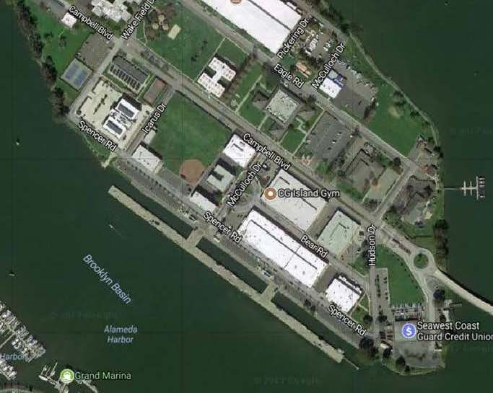
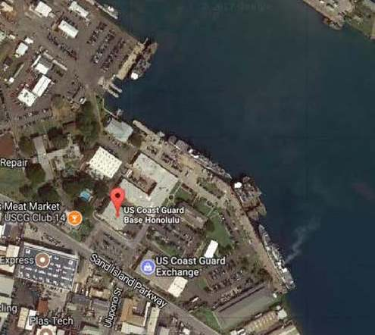
Additional WMSL Homeports
Alameda, CA
Four Hulls
Honolulu, HI
Two Hulls (FY18-20)

Slide 24
Key Schedule Metrics
Fed Biz Opps Posting, Sources Sought
223 days prior to project start date
Solicitation Open
169 days prior to project start date
Contract Award
60 days prior to project start date

Slide 25
Charleston Project Staff
Mr. James Landreth
WMSL Propulsion System, Lead Engineer
james.m.landreth@uscg.mil
LTJG Patrick Beringer
CGC HAMILTON, Port Engineer
patrick.a.beringer@uscg.mil
CWO Miguel Felix
CGC JAMES, Port Engineer
miguel.a.felix@uscg.mil
CWO Brian Clontz
Contracting Officer’s Representative
brian.e.clontz1@uscg.mil
Notes:
Plan and integrate in port maintenance
Manage schedule & funding
Provide logistic support
Work directly with cutter crew, support staff, CG finance, CG supply, CG contracting, and contractors

Slide 26
Resources
Register with the System for Award Management
https://www.sam.gov
Search for opportunities
https://www.fbo.gov
Small Business Administration Resources
https://www.sba.gov

Slide 27
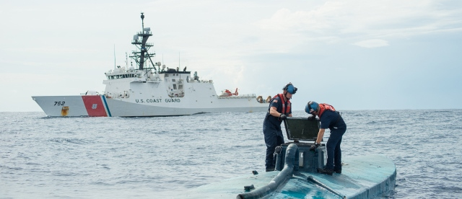
Questions?
Mr. James Landreth, P.E.
SFLC, Charleston, SC
james.m.landreth@uscg.mil

