Slide 1
Your shortest path to solutions.
Corporate Overview

Slide 2
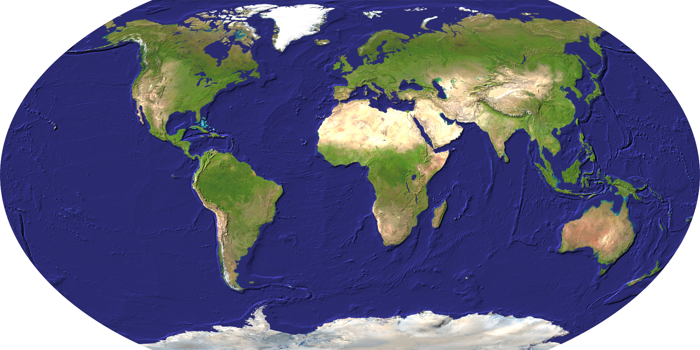
Team
Your shortest path to solutions.

Slide 3
Community
Your shortest path to solutions.

Slide 4
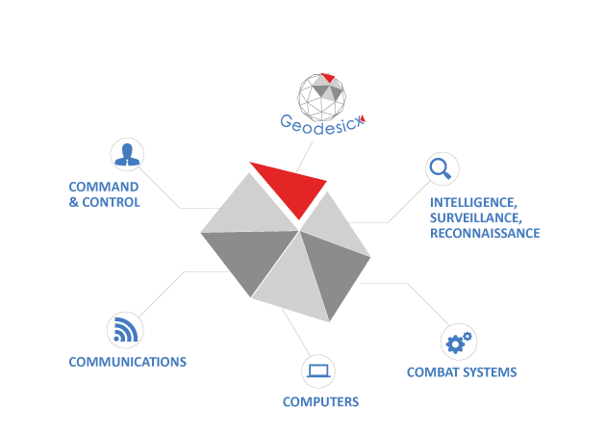
Capabilities
GCCS-M
SeaWatch
Iraq MSS
MTVR
RSNF
USCG
MTVR
TacMobile
RIIKS
Your shortest path to solutions.

Slide 5
Contact Us
Camila Anderson
Business Development
Camila.Anderson@geodesicx.com
843-877-1107 x41 (o)
703-209-3878 (c)
Business Classification: SDVOSB
DUNS NUMBER / CAGE CODE: 14-613-6762 / 3VYF2
Representative Contract Vehicles: Seaport-e, GSA VETS II, SSC PAC MAC T&E
NAICS codes: 541330, 334111, 334290, 334511, 334419, 541511, 54161, 541519, 541611, 541712, 811219
Geodesicx, Inc.
Southeast Regional Office
5401 Netherby Lane, Suite 602 North Charleston, SC 29420
843.277.1107
geodesicx.com
Your shortest path to solutions.

